Slide 1
THE DENTAL PLAN

Slide 2
TOP THREE RISK AREAS FACING DENTISTS

Slide 3
THE TOP 3 RISKS
I
2
3
Cyber Liability
Reputation
Employee Engagement/HR
The Dental Plan for Dentists | Page 3

Slide 4
I. CYBER LIABILITY

Slide 5
CYBER LIABILITY
The Risk is Real
PHI is very expensive to lose
Health information is a hot commodity for many reasons
Health info is highly prized information and sells for much higher dollar amounts on the deep, dark web
Breaches around PHI can be more dangerous because the integrity of the health record can be compromised and result in complications to diagnosis and treatment
Takes much more time and effort to correct the problem which many times, can never be fully satisfactorily completed
The Dental Plan for Dentists | Page 5

Slide 6
CYBER LIABILITY
Understand & Take Control
Complete The Dental Plan Self Guided Cyber Security Assessment
Develop a Cyber Security Action Plan
Utilize Cyber Security Protection to Mitigate Risk
Consult with your Risk Advisor
The Dental Plan for Dentists | Page 6

Slide 7
2. REPUTATION RISK

Slide 8
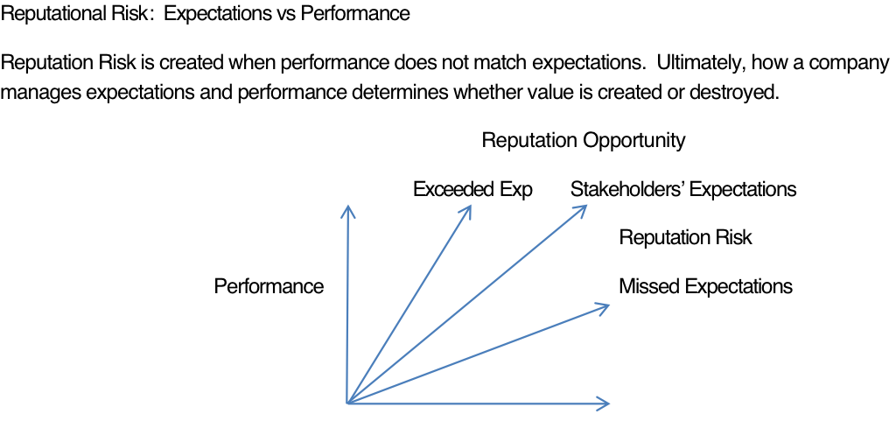
YOUR REPUTATION
?
Reputation is Everything
In a 2014 global survey of more than 300 companies on reputation risk by Deloitte, 87% of the executives surveyed rated reputation risk as more important than other strategic risks
Security, Ethics/Integrity, and Products/Services are the top three drivers of reputation risk
41% if companies that experienced a negative reputation event reported brand value and revenue as the greatest impact
The Dental Plan for Dentists | Page 8

Slide 9
YOUR REPUTATION
Analyze Your Rep
Complete the Reputational Risk Assessment
Develop a Reputation Management Plan
Consider Reputation Management Consulting
Consult your Risk Advisor
The Dental Plan for Dentists | Page 9

Slide 10
3. HUMAN CAPITAL

Slide 11
EMPLOYEE ENGAGEMENT & HUMAN RESOURCES
Steps to Successful Engagement:
I
Clarify Your Culture
4
Take Action
2
Conduct A Survey
5
Over Communicate
3
Share Feedback
6
Get Started – Don’t Wait
The Dental Plan for Dentists | Page 11

Slide 12
EMPLOYEE ENGAGEMENT & HUMAN RESOURCES
Get Engaged!
Conduct with your employees The Employee Engagement Express Survey
Create an Engagement Strategy & Action Plan
Consult your Advisor for Implementation
The Dental Plan for Dentists | Page 12

Slide 13
PROTECTION

Slide 14
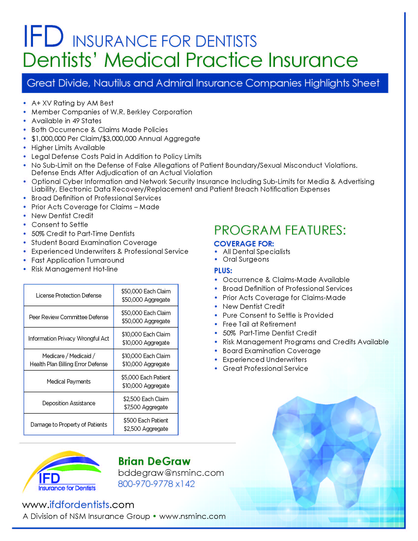
PROTECTION – IFD INSURANCE FOR DENTISTS
The Dental Plan for Dentists | Page 14

