Slide 1
PERSONAL BRANDING WORKBOOK FOR ACCOUNT MANAGERS
Supporting the book:
BRAND AID
Taking Control Of Your Reputation – Before Everyone Else Does
Product of Intellectual Innovations
www.theiionline.com

Slide 2
Branding Guide
Personal Branding is not simply a social media strategy and/or advertising campaign.
A great Personal Brand is one that has a foundation of finding your potential and creating who you want to become.
The complexity of brand identification, communication, and management is difficult. That’s why many people fail and are misunderstood.
This workbook will help you identify and manage all attributes of a strong and powerful Personal Brand!
This “Branding Guide” is a modified version of a more extensive and complete Branding Guide available through Intellectual Innovations at (www.theiionline.com).
BRAND AID For Teenagers
BRAND AID For The Salesperson
BRAND AID For The Family

Slide 3
Identification
Current Brand
How would people you know describe you today? (Fill as many boxes as possible). *See Appendix A and send this document to your family, friends and colleagues to get feedback on your current brand.
Words:
BRAND AID For Teenagers
BRAND AID For The Salesperson
Phrases:
BRAND AID For The Family
1

Slide 4
Identification
Current Brand
List your personal behaviors and traits that are valuable to others in your life.
BRAND AID For Teenagers
BRAND AID For The Salesperson
List your personal behaviors and traits that may cause others frustration or difficulty in your relationships.
BRAND AID For The Family
2

Slide 5
Action Plans
Desired Brand Management Plan
Describe Your Desired Brand:
Describe How You Will Communicate This Brand:
Language
Behaviors
Dress
3

Slide 6
Identification
Ideal Brand Creation
List behaviors and traits you want others to think about you that would maximize your potential in each relationship. *Reference Ideas in Appendix C.
Colleagues:
Brand Item | How will I communicate?
BRAND AID For The Salesperson
BRAND AID For The Family
4

Slide 7
Identification
Ideal Brand Creation
List behaviors and traits you want others to think about you that would maximize your potential in each relationship. *Reference Ideas in Appendix B and C.
Prospects & Clients:
Brand Item | How will I communicate?
BRAND AID For The Salesperson
BRAND AID For The Family
5

Slide 8
Appendix A
Personal Brand Survey
List the words and phrases that best represent the most common traits (positive/negative) and attributes of this person.
*Copy and send this document to your family, friends and colleagues.
Words:
BRAND AID For Teenagers
BRAND AID For The Salesperson
Phrases:
BRAND AID For The Family
6

Slide 9
Appendix B
Social Media Insights
Social media is a critical tool to use in communicating your brand. This guide is not intended to give full instruction and strategy around social media. However, when determining your brand communication methods, social media may be part of your strategy. The ideas below can be used to enhance your use of social media when communicating your brand.
Recognize that any post on social media will have an impact on your brand. So, think before you post or ask yourself… “What will others think of me when they read this?”
Always remember who you are connected to on social media. A political or religious post intended for close friends may offend a client. Keep the entire audience in mind on every post
Pictures can describe you. People will look at your pictures. Review your pictures and see what story they tell
Social media is a great tool for connection and relationship building. Look for ways to express your brand to increase connection in relationships
Consider removing connection with people that may damage your brand
Think of ways to tie in your brand with the frequency of posting content along with the language you use
Remember that there is NO SUCH THING AS PRIVACY on the internet. Multiple servers hit every internet action on social media. Even if something is considered private today or is deleted after a minute, it is recorded somewhere. So, treat every activity on the internet with the thought that it will be displayed for the world to see at some point and time
BRAND AID For The Salesperson
BRAND AID For The Family
7

Slide 10
Appendix C
Brand Communication Ideas
We express our brand in numerous ways that many people don’t recognize. The following list includes a few of the methods used by some the best personal brand managers in the world. Consider these strategies when building your communication strategies and action plans.
Dress: How you dress will influence what others think of you. So wear clothes that represent the brand that you desire
Key Conversation Starters: If you let others drive conversations they may create brand items for you. When at networking events have 2-3 conversation starting statements that will allow your brand to be recognized
Brand Association Techniques: It’s a terrible truth that people will create judgment about others through words, dress, attitudes, etc. Be aware of what things associate with your brand. Examples: Reading = intelligent, so refer to books you read. Thought Leader = Sharing insights on current events
Daily language: Think about what you say to others. It will impact the brand you are developing
New Skills / Habits Developed: Sometimes we have to develop a new skill to create our desired brand. It may be reading more frequently, not drinking at business events, understanding finance, etc.
Through Others: Some effective brand managers have communicated their desired brand to others who are close to them. The natural tendency is for these relationships to share those brand items with others. This is also a very good brand damage tool. The introvert in the story above has numerous colleagues that help others understand him better because they know his real brand and perceived brand
Be aware of the “pretty girl syndrome”. Remember the pretty girl that people would brand as “she thinks she is so pretty”? Well, sometimes we have traits we can’t do anything about. However, being aware of those traits and finding ways to offset them can be critical. An introvert friend of mine is perceived as being cocky and self focused because he is uncomfortable interacting with others. He sends personal notes, calls people one-on-one, and communicates specifics about caring for others frequently to offset this perception
BRAND AID For The Salesperson
BRAND AID For The Family
8

Slide 11
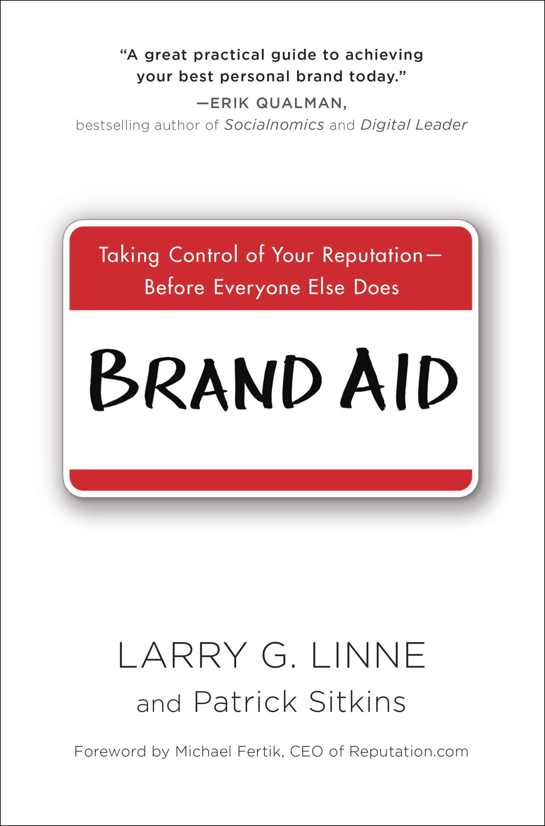
Product Of Intellectual Innovations
www.theiionline.com
This workbook is property of Intellectual Innovation. All rights reserved. No part may be reproduced, distributed or transmitted in any form (Brand Survey may be copied).

